Slide 1
FPGA SPI Master–Slave Sensor System

Slide 2
Introduction
Introduction

Slide 3
System Block Diagram
System Block Diagram

Slide 4
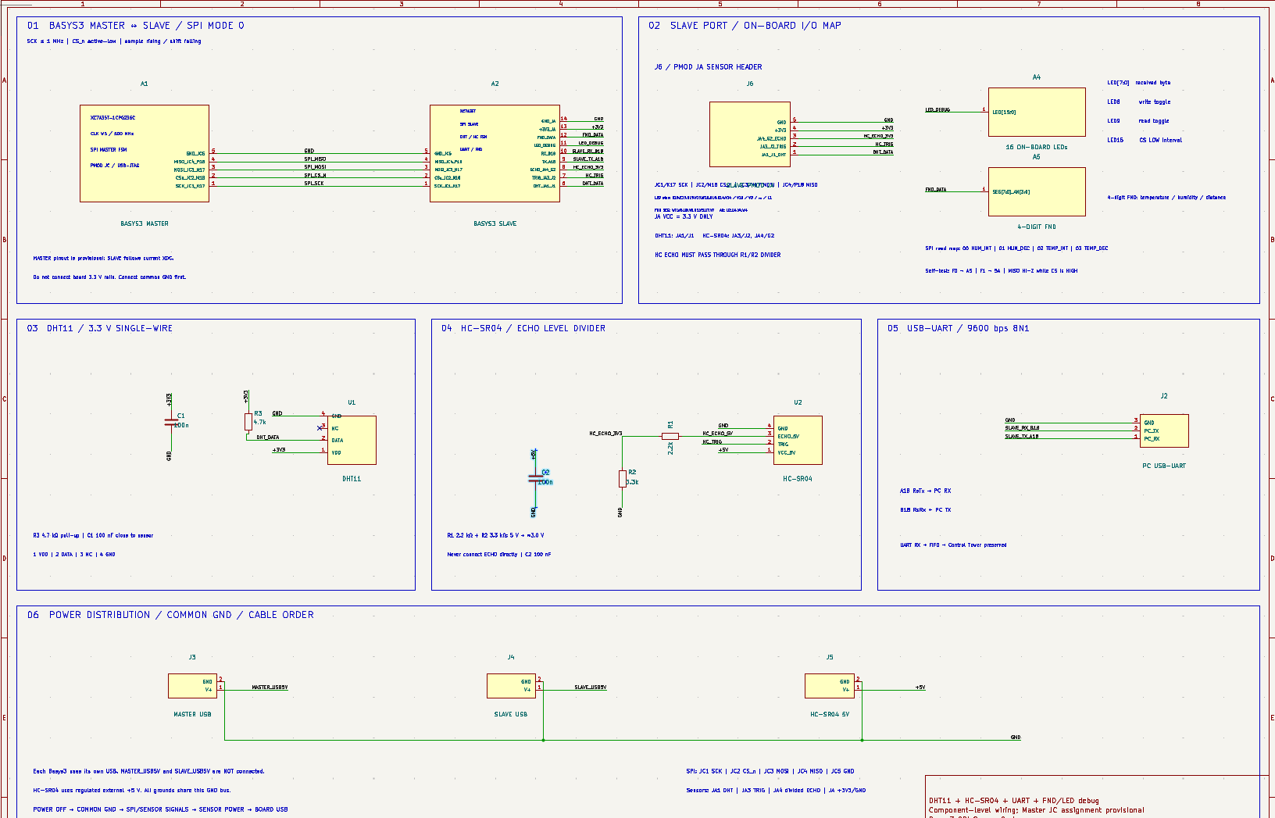
Hardware Architecture

Slide 5
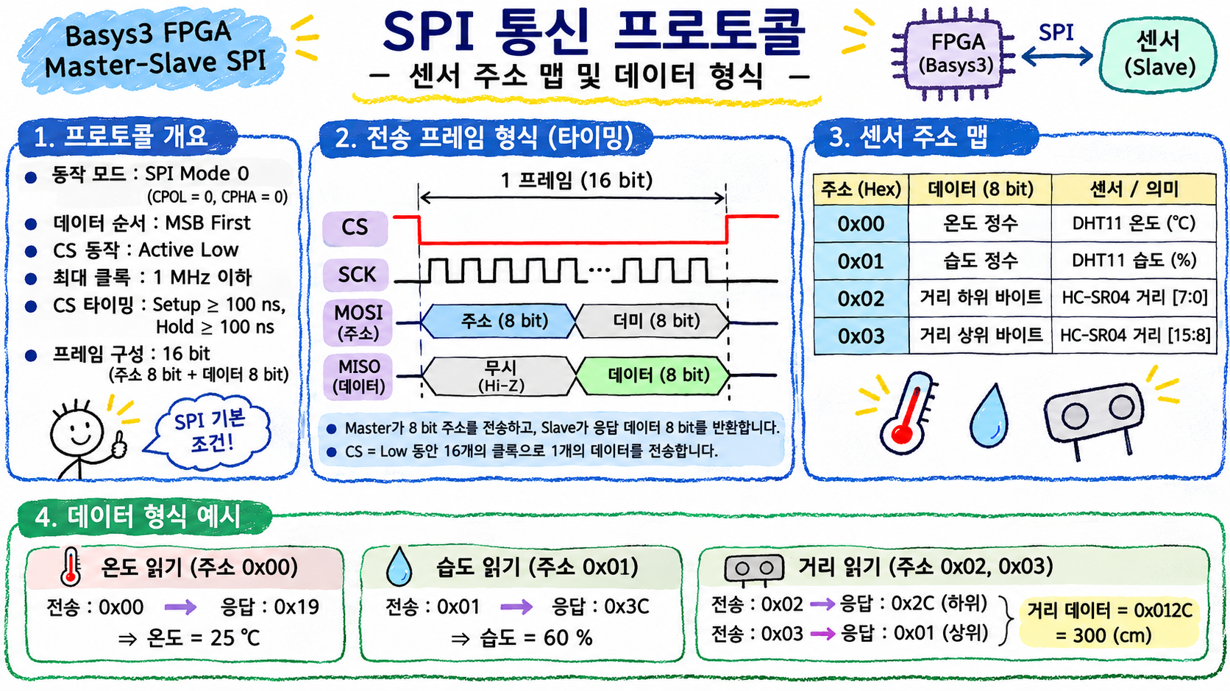
SPI 통신 프로토콜
통신 방식
SPI Mode 0 (CPOL=0, CPHA=0)
최대 통신 속도 1MHz, MSB First
CS Active Low
주소 8비트 + 데이터 8비트, 총 16클록
2. 통신 방식
① Master가 센서 주소 전송 (MOSI)
② Slave가 해당 주소의 센서 데이터 선택
③ Slave가 8비트 데이터를 반환 (MISO)
④ Master가 수신 데이터를 FND/UART에 출력

Slide 6
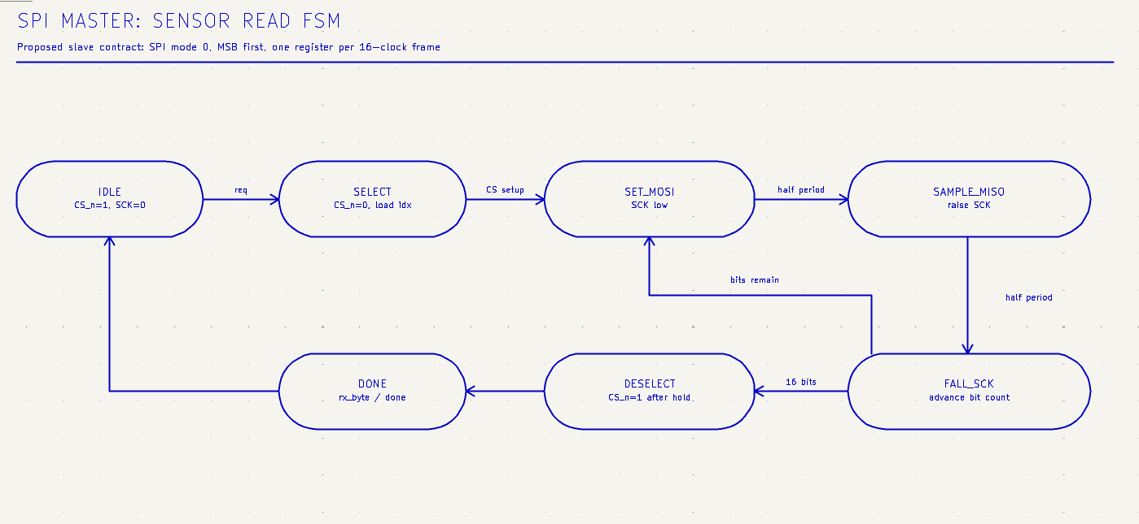
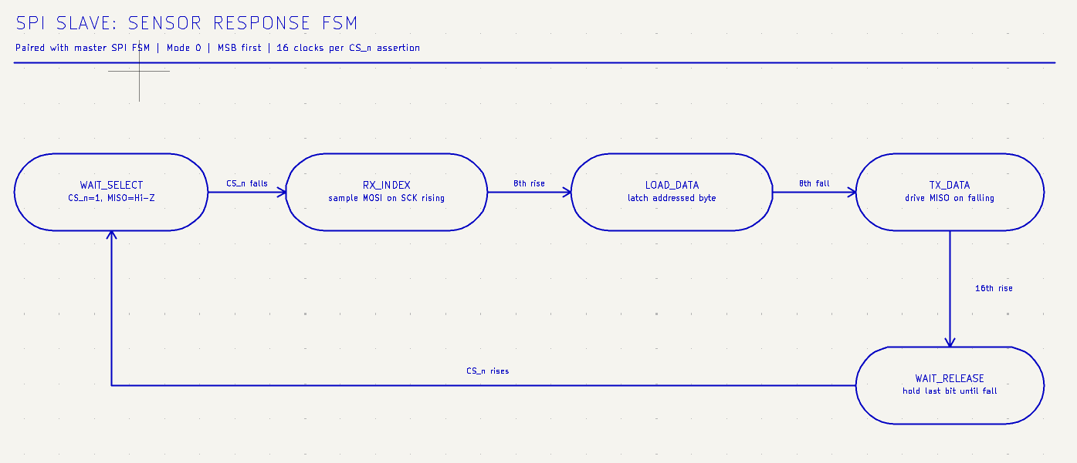
SPI Master- Slave FSM
SPI- Master- FSM
SPI- SLAVE- FSM

Slide 7
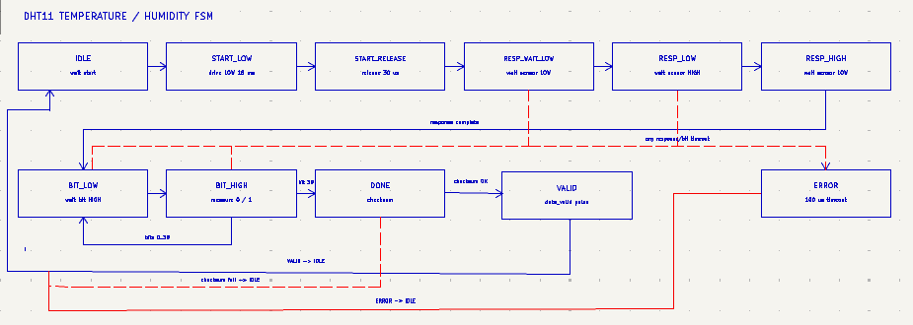
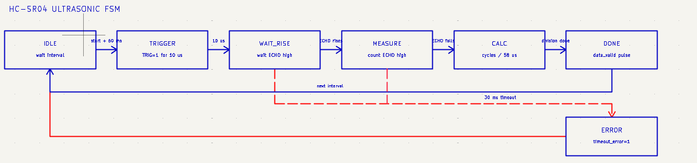
Sensor - FSM
DHT11 FSM
HC-SR04 FSM

Slide 8
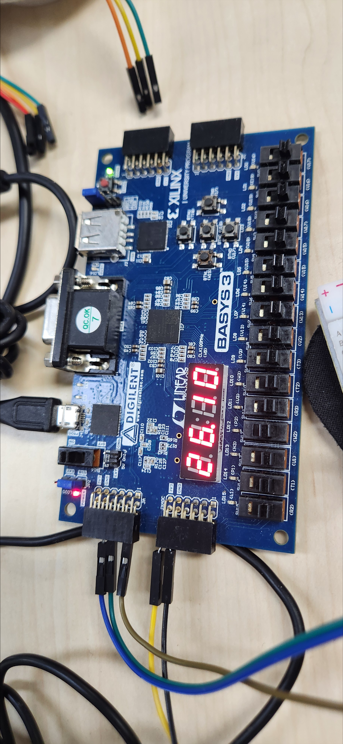
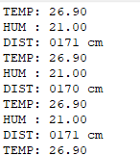
Trobleshooting – Uart , FND UART 및 FND 데이터 갱신 지연 문제

Slide 9
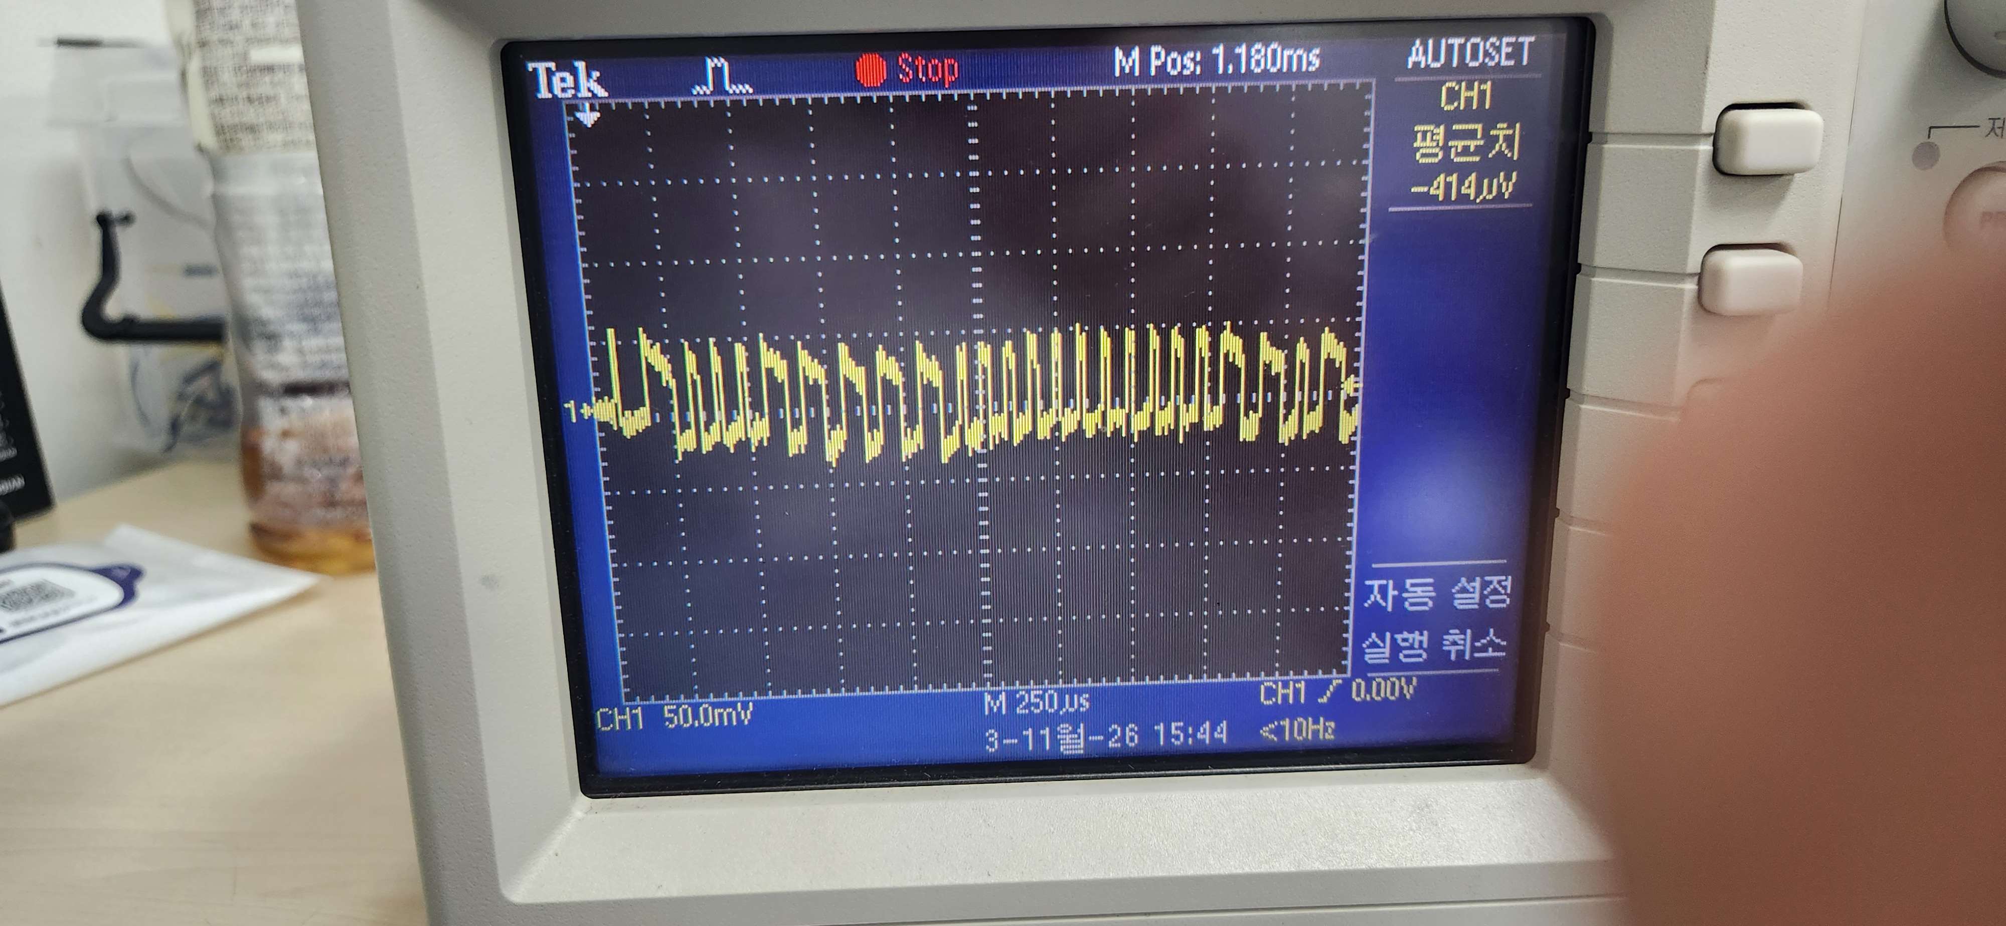
Trobleshooting
하드웨어 검증 확인
오실로스코프로 DHT11 DATA 신호의 변화 여부 확인
센서 데이터 라인에서 반복적인 신호 변화 관측
하드웨어 신호 문제 없는걸 확인함

Slide 10
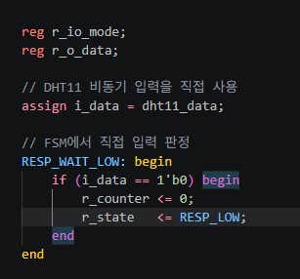
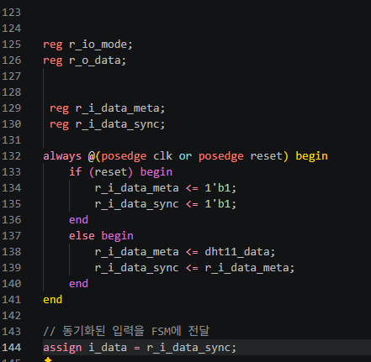
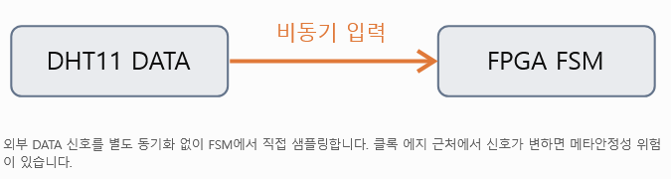
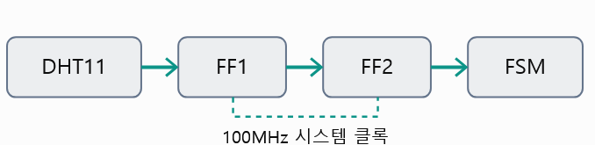
BEFORE
AFTER

Slide 11
Trobleshooting
추가할 내용 있으면 추가 하기 없으면
(제거)

Slide 12
Testbench -Master
Testbench -Slave
(시뮬레이션)
필요 없으면 제거
(시뮬레이션)
필요 없으면 제거

Slide 13
결론
구현 후기 및 개선 방향

Slide 14
시연 영상
시연 영상

Slide 15
TIMELINE
타임 라인
SPI Master –Slave 기반 센서 시스템을 단계별로 나타낸 일정입니다.
11.03
11.06
역할 분담
RTL 설계 및 구현(SPI,DHT11,HC-SR04)
Brand asset design
SPI Master 구현
SPI Slave 구현
센서 연동(온습도, 거리)
FND /Uart 출력
디버깅 및 기능 개선 (Troubleshooting)

Slide 16
26 JUNE 2024
Q&A

Slide 17
SECTION NAME

Slide 18
SECTION NAME
“
A quote from a customer, user, or other stakeholder that helps back up the points you are trying to make on the previous or upcoming slides.
—JANE DOE

Slide 19
SECTION NAME
“
A quote from a customer, user, or other stakeholder that helps back up the point you’re trying to make on this slide.
— JANE DOE

Slide 20
SECTION NAME
An obtuse angle is an angle greater than a right angle.
“
A quote from a customer, user, or other stakeholder that helps back up the point you’re trying to make on this slide.
Longer description of slide content. Typically used to provide extra context or nuance to slides. A good description ensures slides can be consumed async without a live presentation.
— JANE DOE

Slide 21
SECTION NAME
“
A quote from a customer, user, or other stakeholder that helps back up the point you’re trying to make on this slide.
An acute angle is less
than a right angle.
— JANE DOE
Longer description of slide content. Typically used to provide extra context or nuance to slides. A good description ensures slides can be consumed async without a live presentation.
“
A quote from a customer, user, or other stakeholder that helps back up the point you’re trying to make on this slide.
— JANE DOE

Slide 22
SECTION NAME
A triangle whose three sides are equal, is said to be equilateral.
Check list item 1
Check list item 2
Check list item 3
Longer description of slide content. Typically used to provide extra context or nuance to slides. A good description ensures slides can be consumed async without a live presentation.
Check list item 4
Check list item 5

Slide 23
SECTION NAME
+330K
The extremities of a surface are lines.
Metric details and caveats
+103%
Longer description of slide content. Typically used to provide extra context or nuance to slides. A good description ensures slides can be consumed async without a live presentation.
Metric details and caveats
-18%
Metric details and caveats

Slide 24
PROS
CONS
First point
Second point
Third point
Fourth point
First point
Second point
Third point
Fourth point

